Slide 1
Binary Heap

Slide 2
Introduction
A tree with specific properties
A complete tree. All level filled except the last level.
It can be stored as a simple array data structure
It’s a min or a max Heap. Min mean that the root is the minimum value. Max the root is the maximal value.
In this document we refer to the min version.

Slide 3
Applications
Heap Sort, slower in practice than a quicksort but has a worst case of O(n log n) compared to O(n²) for quicksort.
Priority queue
Graph algorithm like Dijkstra's

Slide 4
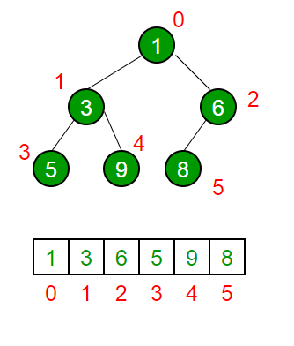
Data structure
The rules are as follow.
Root is at index 0
Parent node index is (currentIndex-1)/2
Left Child index is (2*i) + 1
Right Child : (2*i) + 2
Parent is always lower or equal in value than it’s children
Tree cannot have hole.

Slide 5
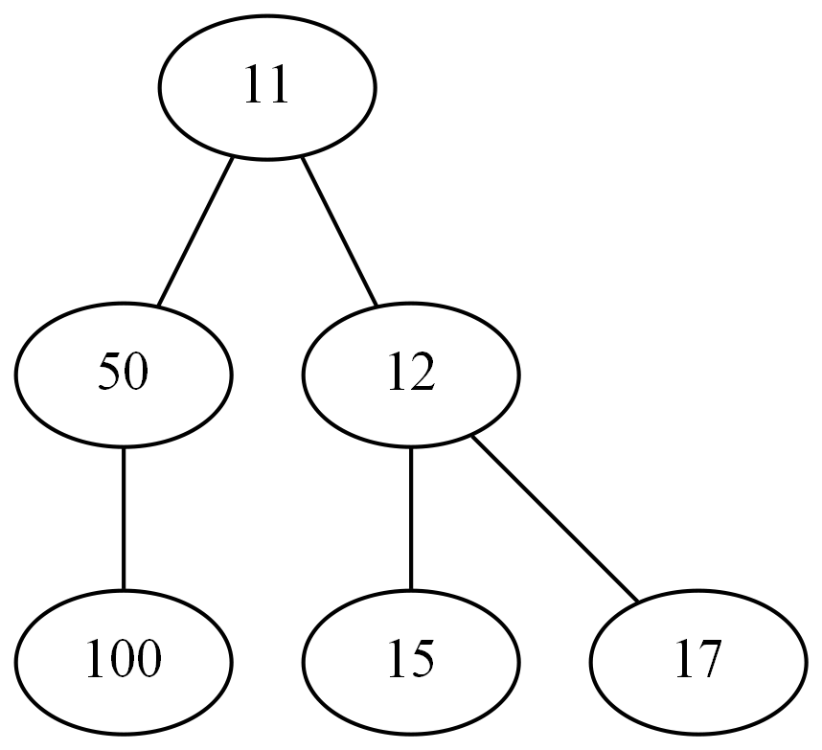
Exercises – Is this Tree Valid?

Slide 6
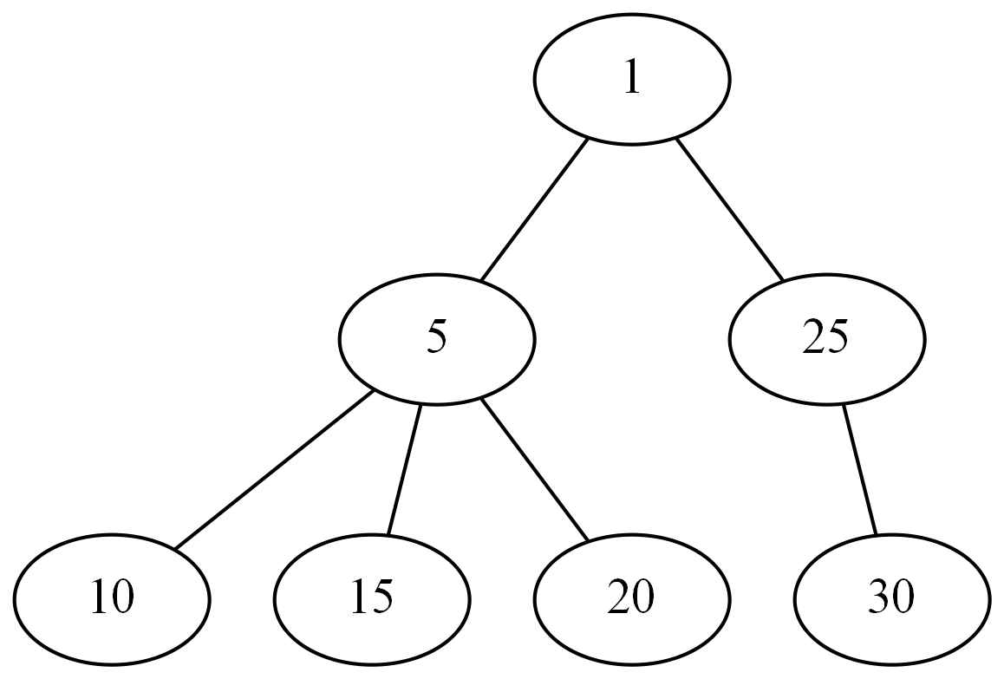
Exercises – Is this Tree Valid?

Slide 7
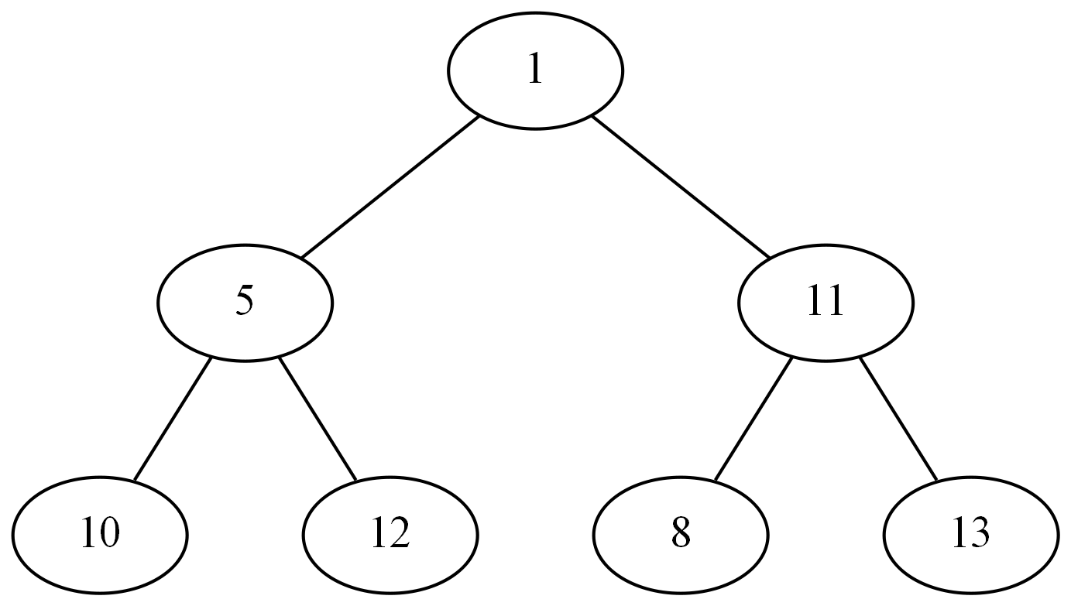
Exercises – Is this Tree Valid?

Slide 8
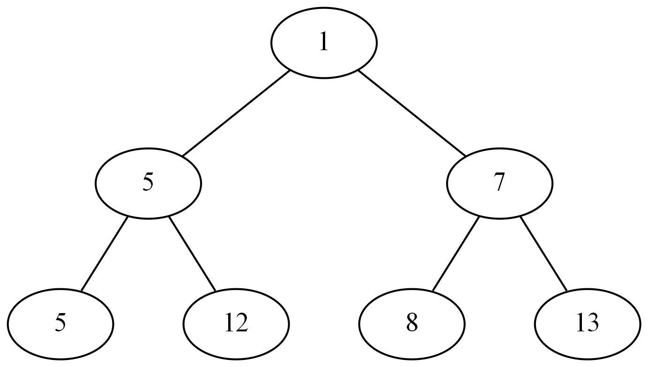
Exercises – Is this Tree Valid?

Slide 9
Operations
GetMin() O(1)
ExtractMin() O(logn)
Insert() O(logn)
Delete() O(logn)

Slide 10
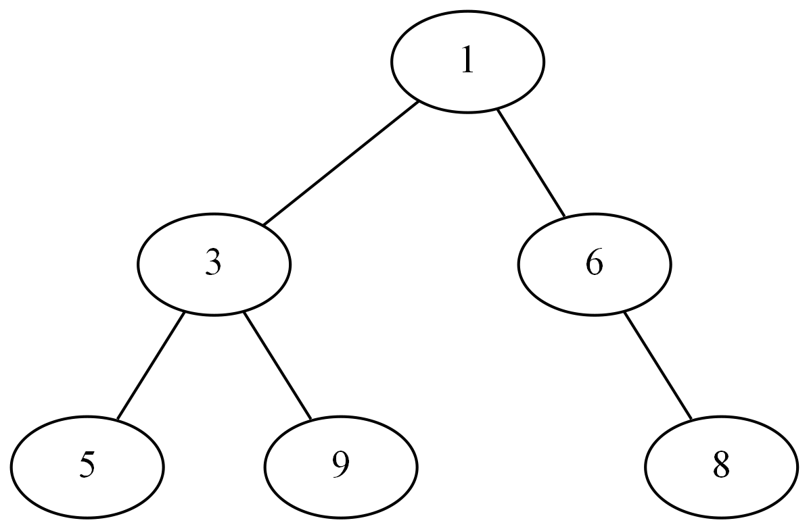
Example 1 – Adding an element

Slide 11
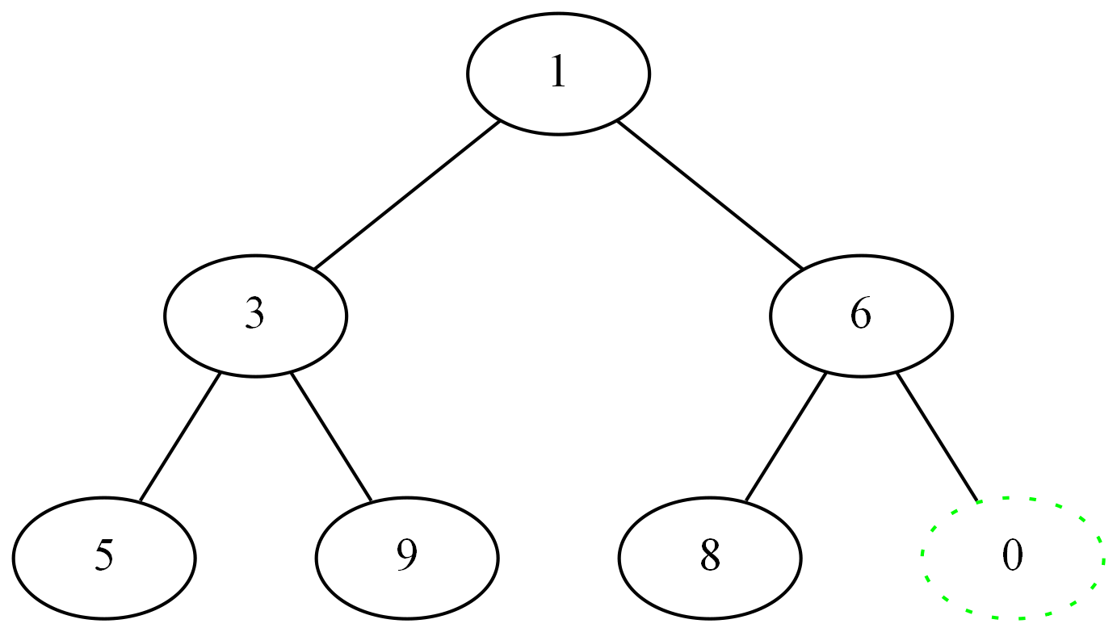
Example 1 – Adding an element

Slide 12
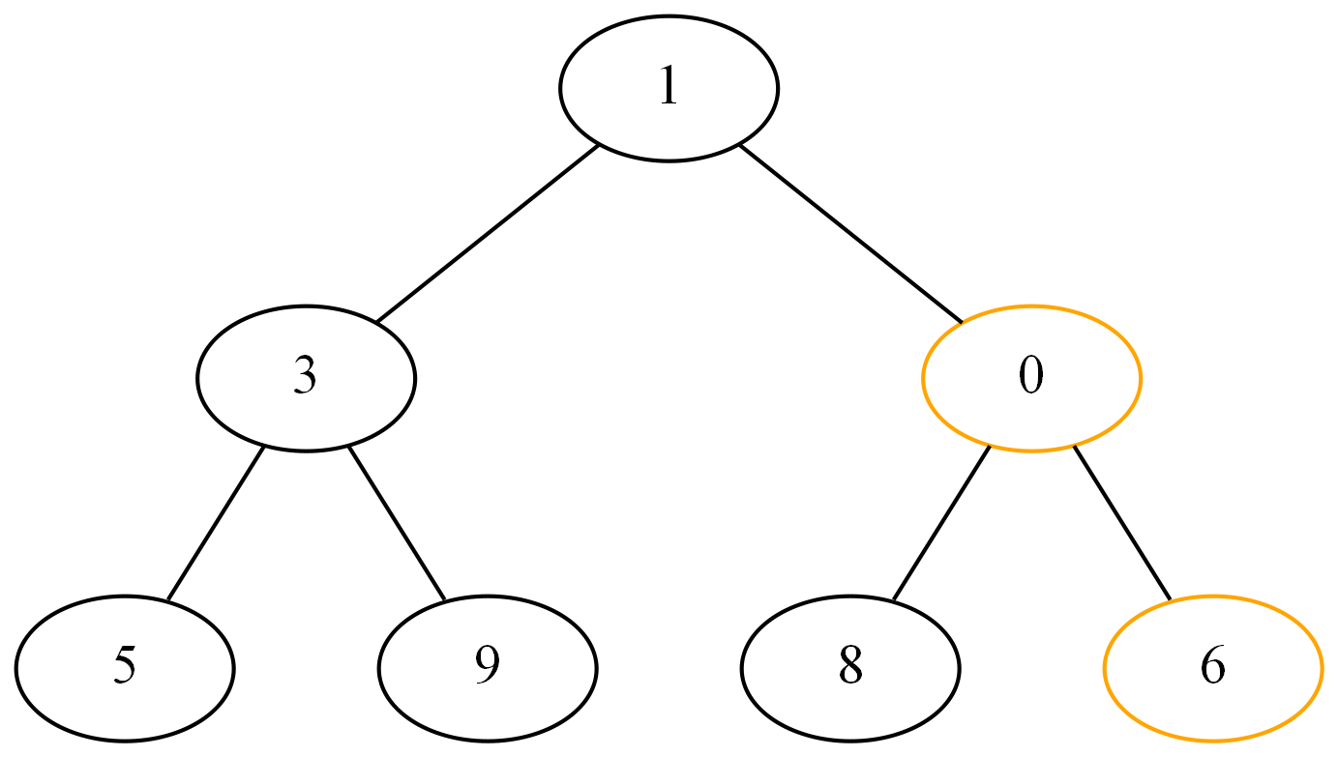
Example 1 – Adding an element

Slide 13
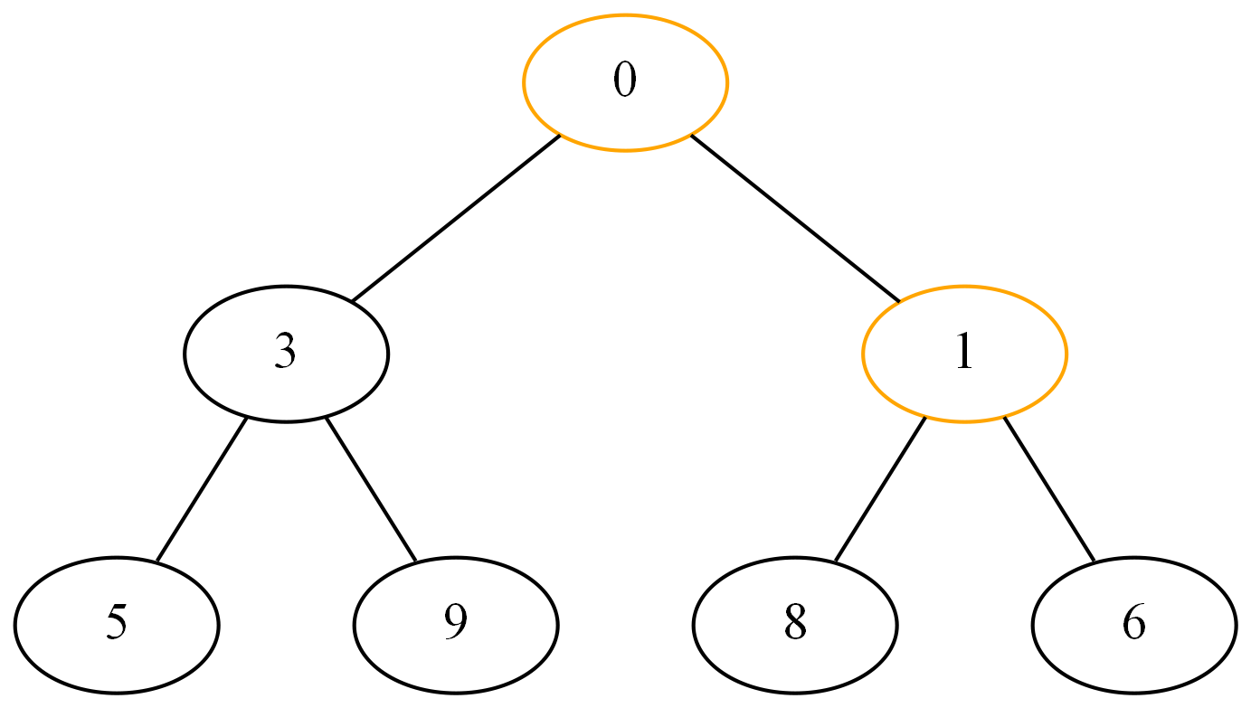
Example 1 – Adding an element

Slide 14
Example 2 – Removing the root
Move last element at root
Trickle down that element until it has no child with lower value

Slide 15
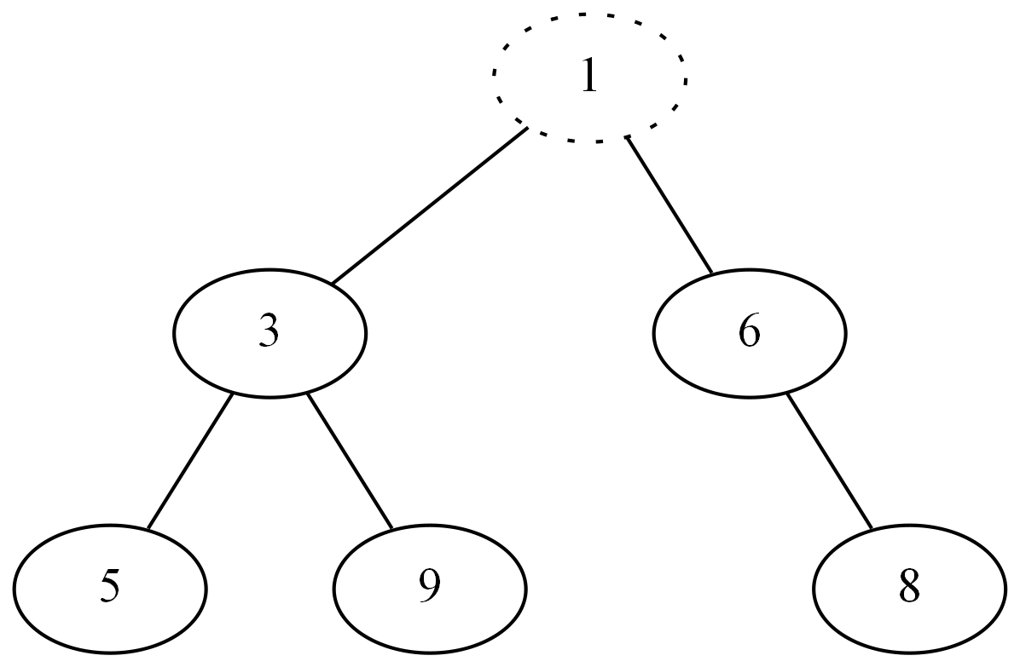
Example 2 – Removing the root

Slide 16
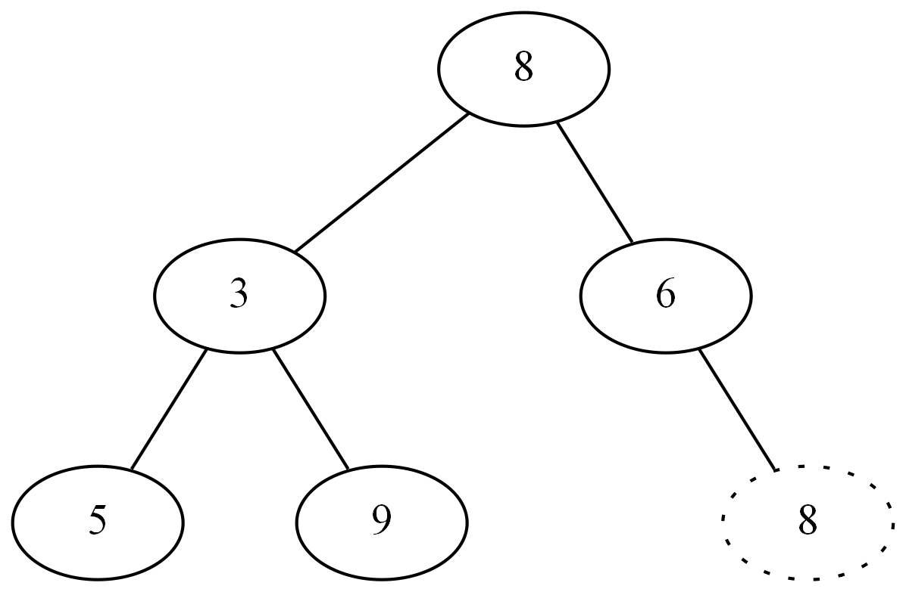
Example 2 – Removing the root

Slide 17
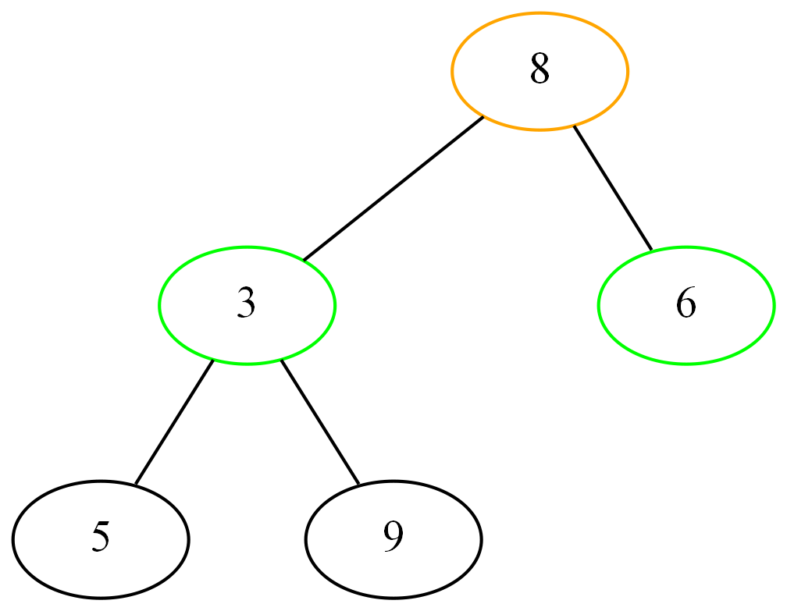
Example 2 – Removing the root

Slide 18
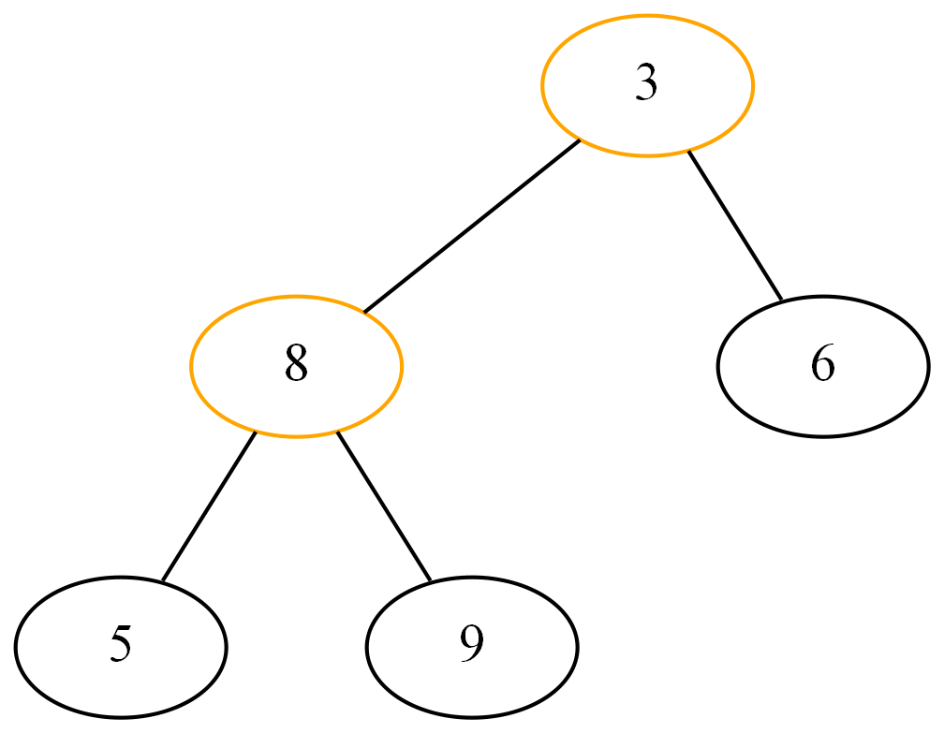
Example 2 – Removing the root

Slide 19
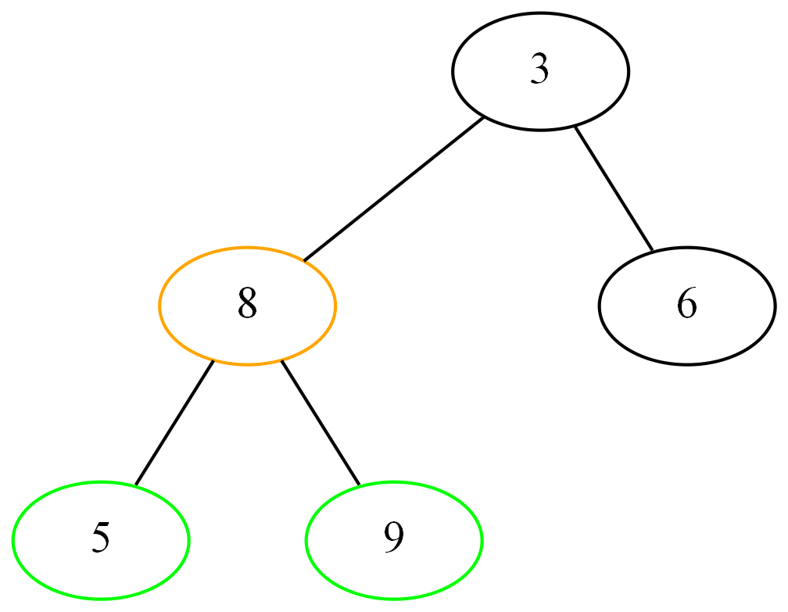
Example 2 – Removing the root

Slide 20
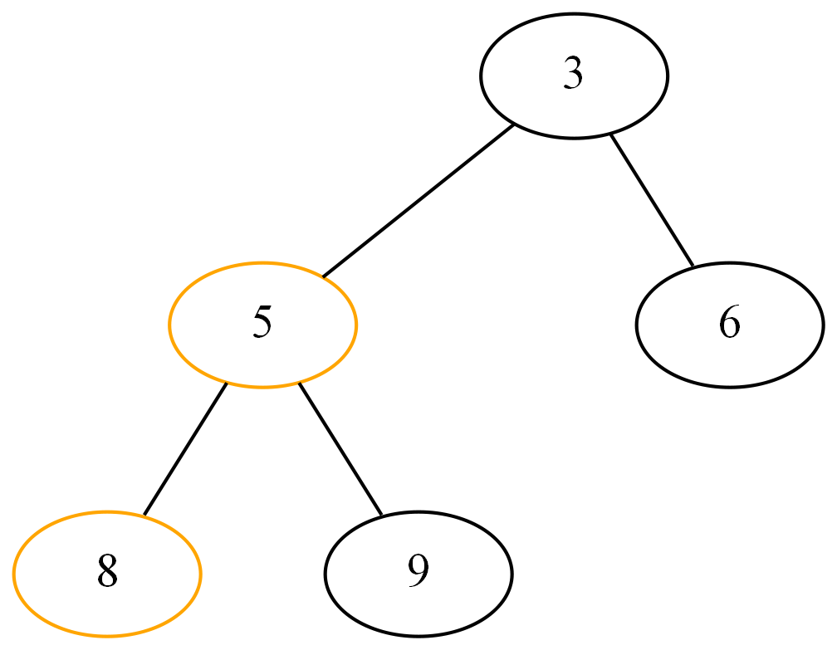
Example 2 – Removing the root

Slide 21
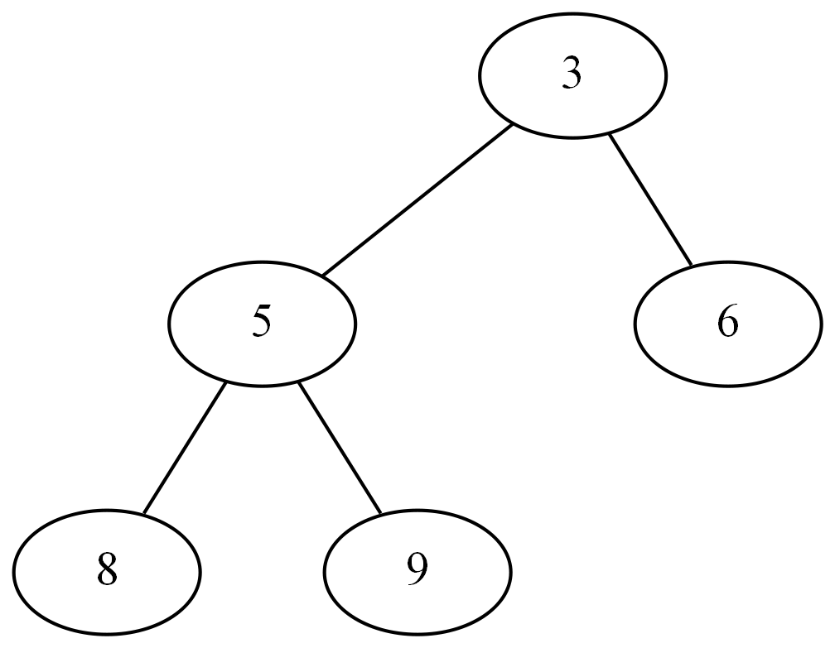
Example 2 – Removing the root

Slide 22
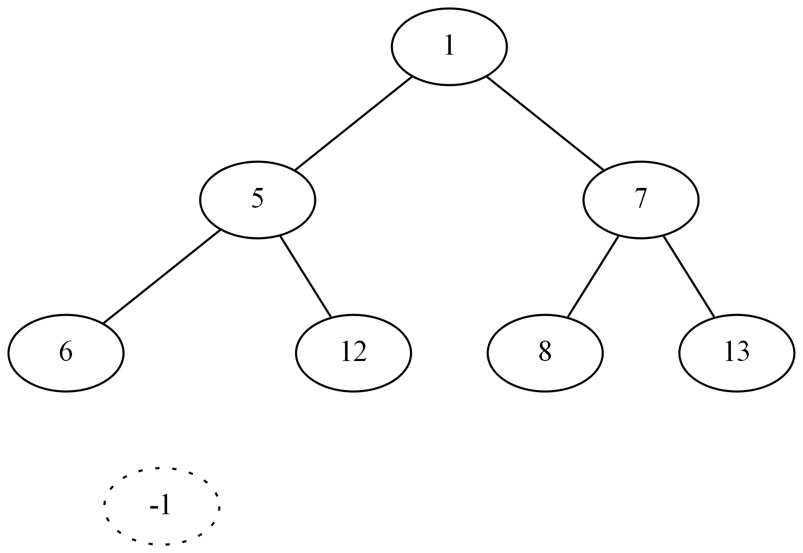
Exercises – Insert

Slide 23
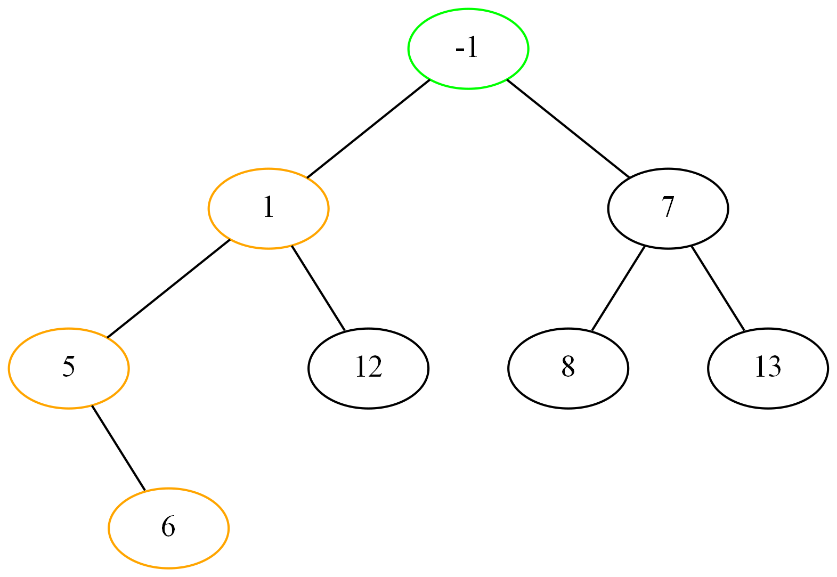
Exercises – Insert

Slide 24
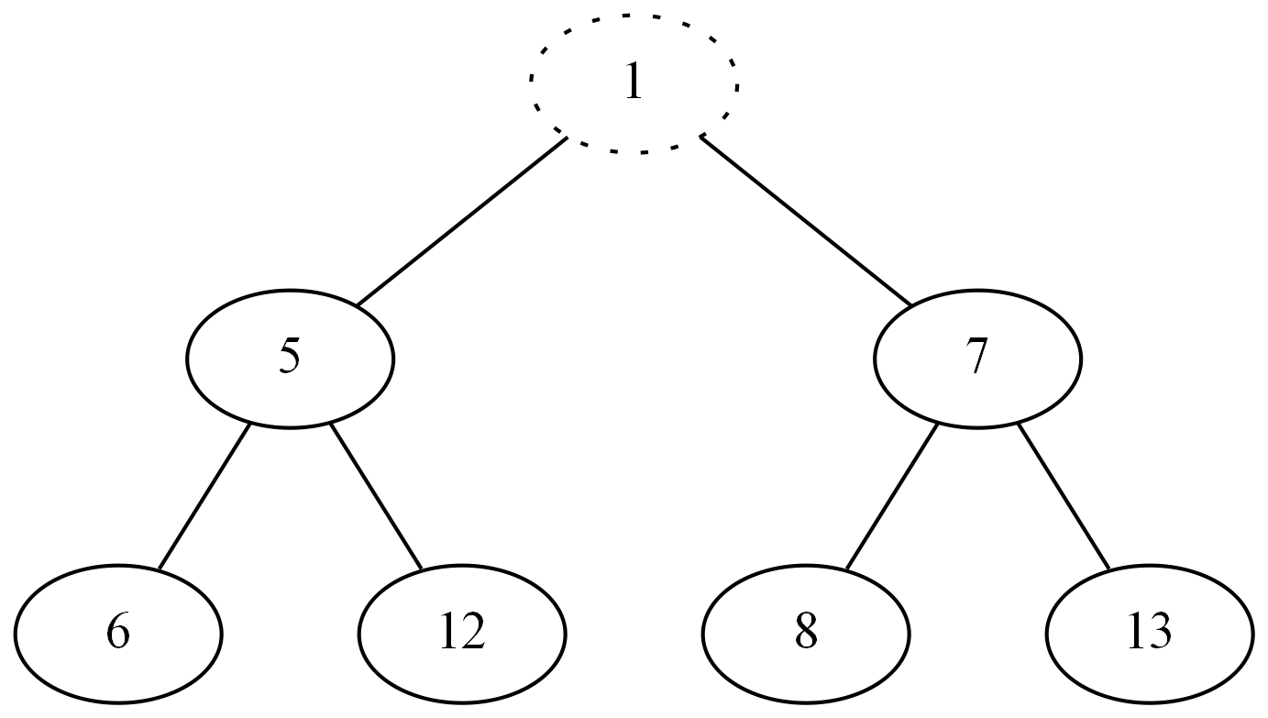
Exercises – Remove Min

Slide 25
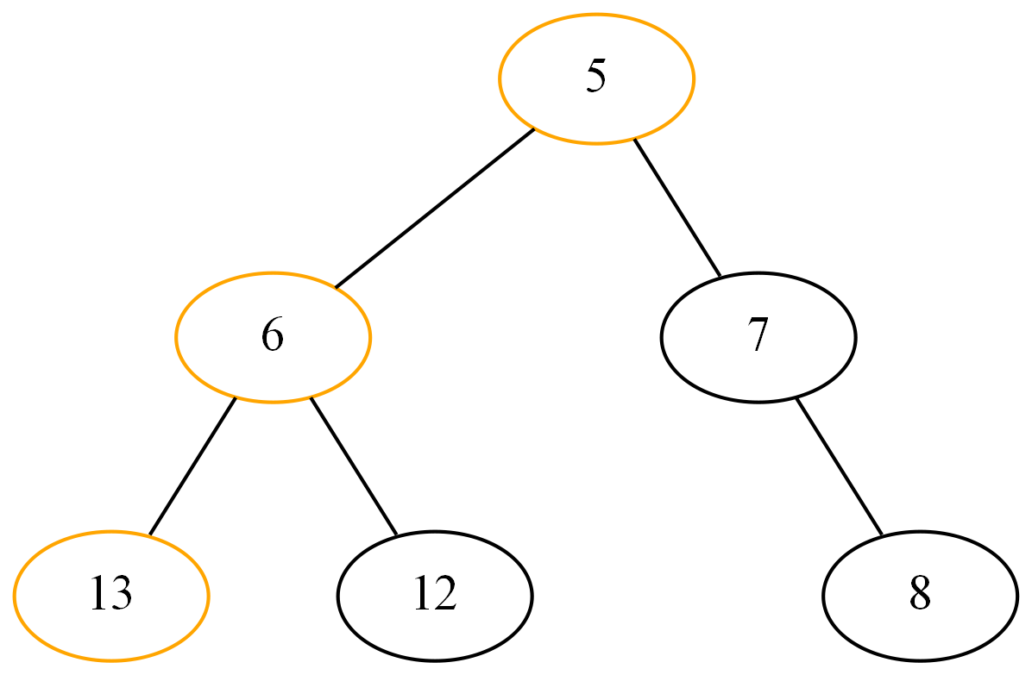
Exercises – Remove Min

Slide 26
Code
https://github.com/maxbegin/BinaryHeap/blob/master/Source/BinaryHeap.cpp

Slide 27
Links and References
https://www.geeksforgeeks.org/(binary-heap/)/
https://www.cs.cmu.edu/~adamchik/15-121/lectures/Binary%20Heaps/heaps.html
http://btv.melezinek.cz/binary-heap.html (Animated)

